Slide 1
CS-205
Declarative Programming
Welcome
to
CS-205 Declarative Programming!
Dr Monika Seisenberger, Dr Xiuyi Fan

Slide 2
CS-205
Declarative Programming
Lectures Tue 11-12 Thurs 5-6
Practicals: Tue 12:00-14:00, Thurs 14-16
Practical start this week: Tue 12-13 [A-L],
Tue 13-14 [M-Z]
Thursday, also in 2 groups.
Assessment:
Exam (70%), 2 Assignments (10% each)
10% weekly lab work.
Info: see Blackboard.

Slide 3
Declarative Programming
Part 1: Functional Programming
Part 2: Logic Programming
Learning outcomes:
Students will be able to specify and write programs in functional and logic programming languages.
They will be able to develop solutions to algorithmic problems using declarative rather than procedural concepts.

Slide 4
Literature for Part I:
Graham Hutton: Programming in Haskell, Cambridge University Press, 2nd edition, 2016.
Learn You a Haskell for Great Good! http://learnyouahaskell.com
[Very concise summary]
Further reading will be given on Blackboard.
2

Slide 5
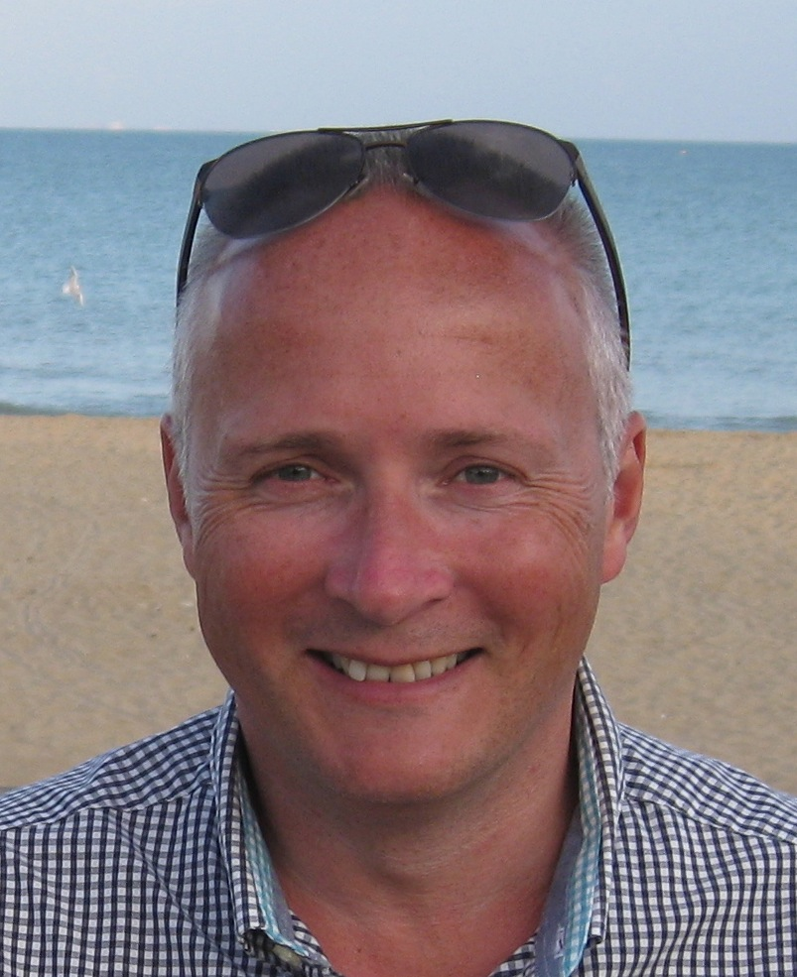
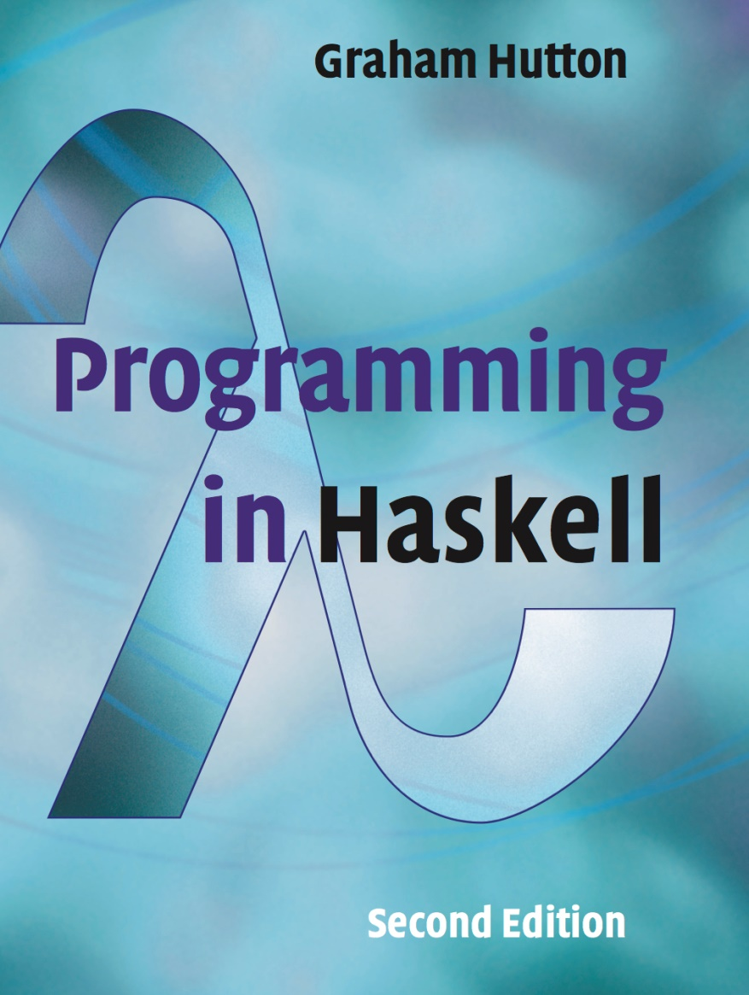

Slide 6

PROGRAMMING IN HASKELL
Chapter 1 - Introduction

Slide 7
The Software Crisis
How can we cope with the size and complexity of modern computer programs?
How can we reduce the time and cost of program development?
How can we increase our confidence that the finished programs work correctly?

Slide 8
Programming Languages
One approach to the software crisis is to design new programming languages that:
Allow programs to be written clearly, concisely, and at a high-level of abstraction;
Support reusable software components;
Encourage the use of formal verification;

Slide 9

Permit rapid prototyping;
Provide powerful problem-solving tools.
Functional languages provide a particularly elegant framework in which to address these goals.

Slide 10
What is a Functional Language?
Opinions differ, and it is difficult to give a precise definition, but generally speaking:
Functional programming is style of programming in which the basic method of computation is the application of functions to arguments;
A functional language is one that supports and encourages the functional style.

Slide 11
First Comparsion: Java - Haskell
Summing the integers 1 to 10 in Java:
total = 0;
for (i = 1; i ≤ 10; ++i)
total = total+i;
The computation method is variable assignment.

Slide 12
First comparison: Java - Haskell
Summing the integers 1 to 10 in Haskell:
sum [1..10]
The computation method is function application.
[Better examples to come. ]

Slide 13
A Taste of Haskell
f [] = []
f (x:xs) = f ys ++ [x] ++ f zs
where
ys = [a | a ← xs, a ≤ x]
zs = [b | b ← xs, b > x]
?

Slide 14
Here two simpler programs:
double :: Int -> Int
double x = x + x

Slide 15
Here two simpler programs:
average :: Float -> Float -> Float
average x y = (x + y) / 2

Slide 16
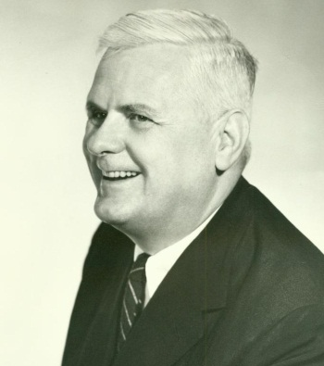
Historical Background
1930s:
Alonzo Church develops the lambda calculus, a simple but powerful theory of functions.

Slide 17
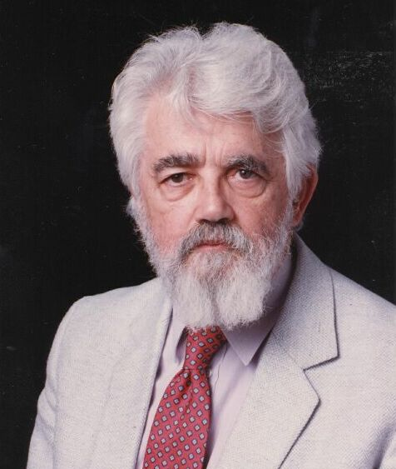
Historical Background
1950s:
John McCarthy develops Lisp, the first functional language, with some influences from the lambda calculus, but retaining variable assignments.

Slide 18
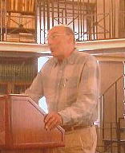
Historical Background
1960s:
Peter Landin develops ISWIM, the first pure functional language, based strongly on the lambda calculus, with no assignments.

Slide 19
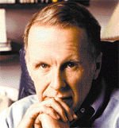
Historical Background
1970s:
John Backus develops FP, a functional language that emphasizes higher-order functions and reasoning about programs.

Slide 20
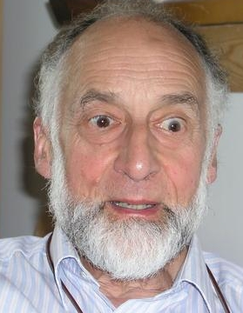
Historical Background
1970s:
Robin Milner and others develop ML, the first modern functional language, which introduced type inference and polymorphic types.

Slide 21

Historical Background
1970s - 1980s:
David Turner develops a number of lazy functional languages, culminating in the Miranda system.

Slide 22
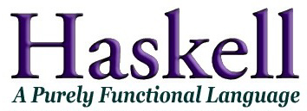
Historical Background
1987:
An international committee of researchers initiates the development of Haskell, a standard lazy functional language.

Slide 23
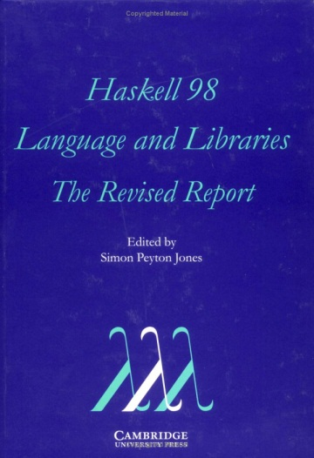
Historical Background
2003:
The committee publishes the Haskell 98 report, defining a stable version of the language.

Slide 24
Industrial Applications
Recommended is to have a look at:
wiki.haskell.org/Haskell_in_industry

